Slide 1

Dr. Charles Severance
Sakai PMC Chair
University of Michigan
Sakai Chief Strategist, Longsight

Slide 2

A Banner Year

Slide 3


Core Values
Open Source
Open Community
Open Planning / Roadmap
Our "shareholders" are the adopters and users

Slide 4
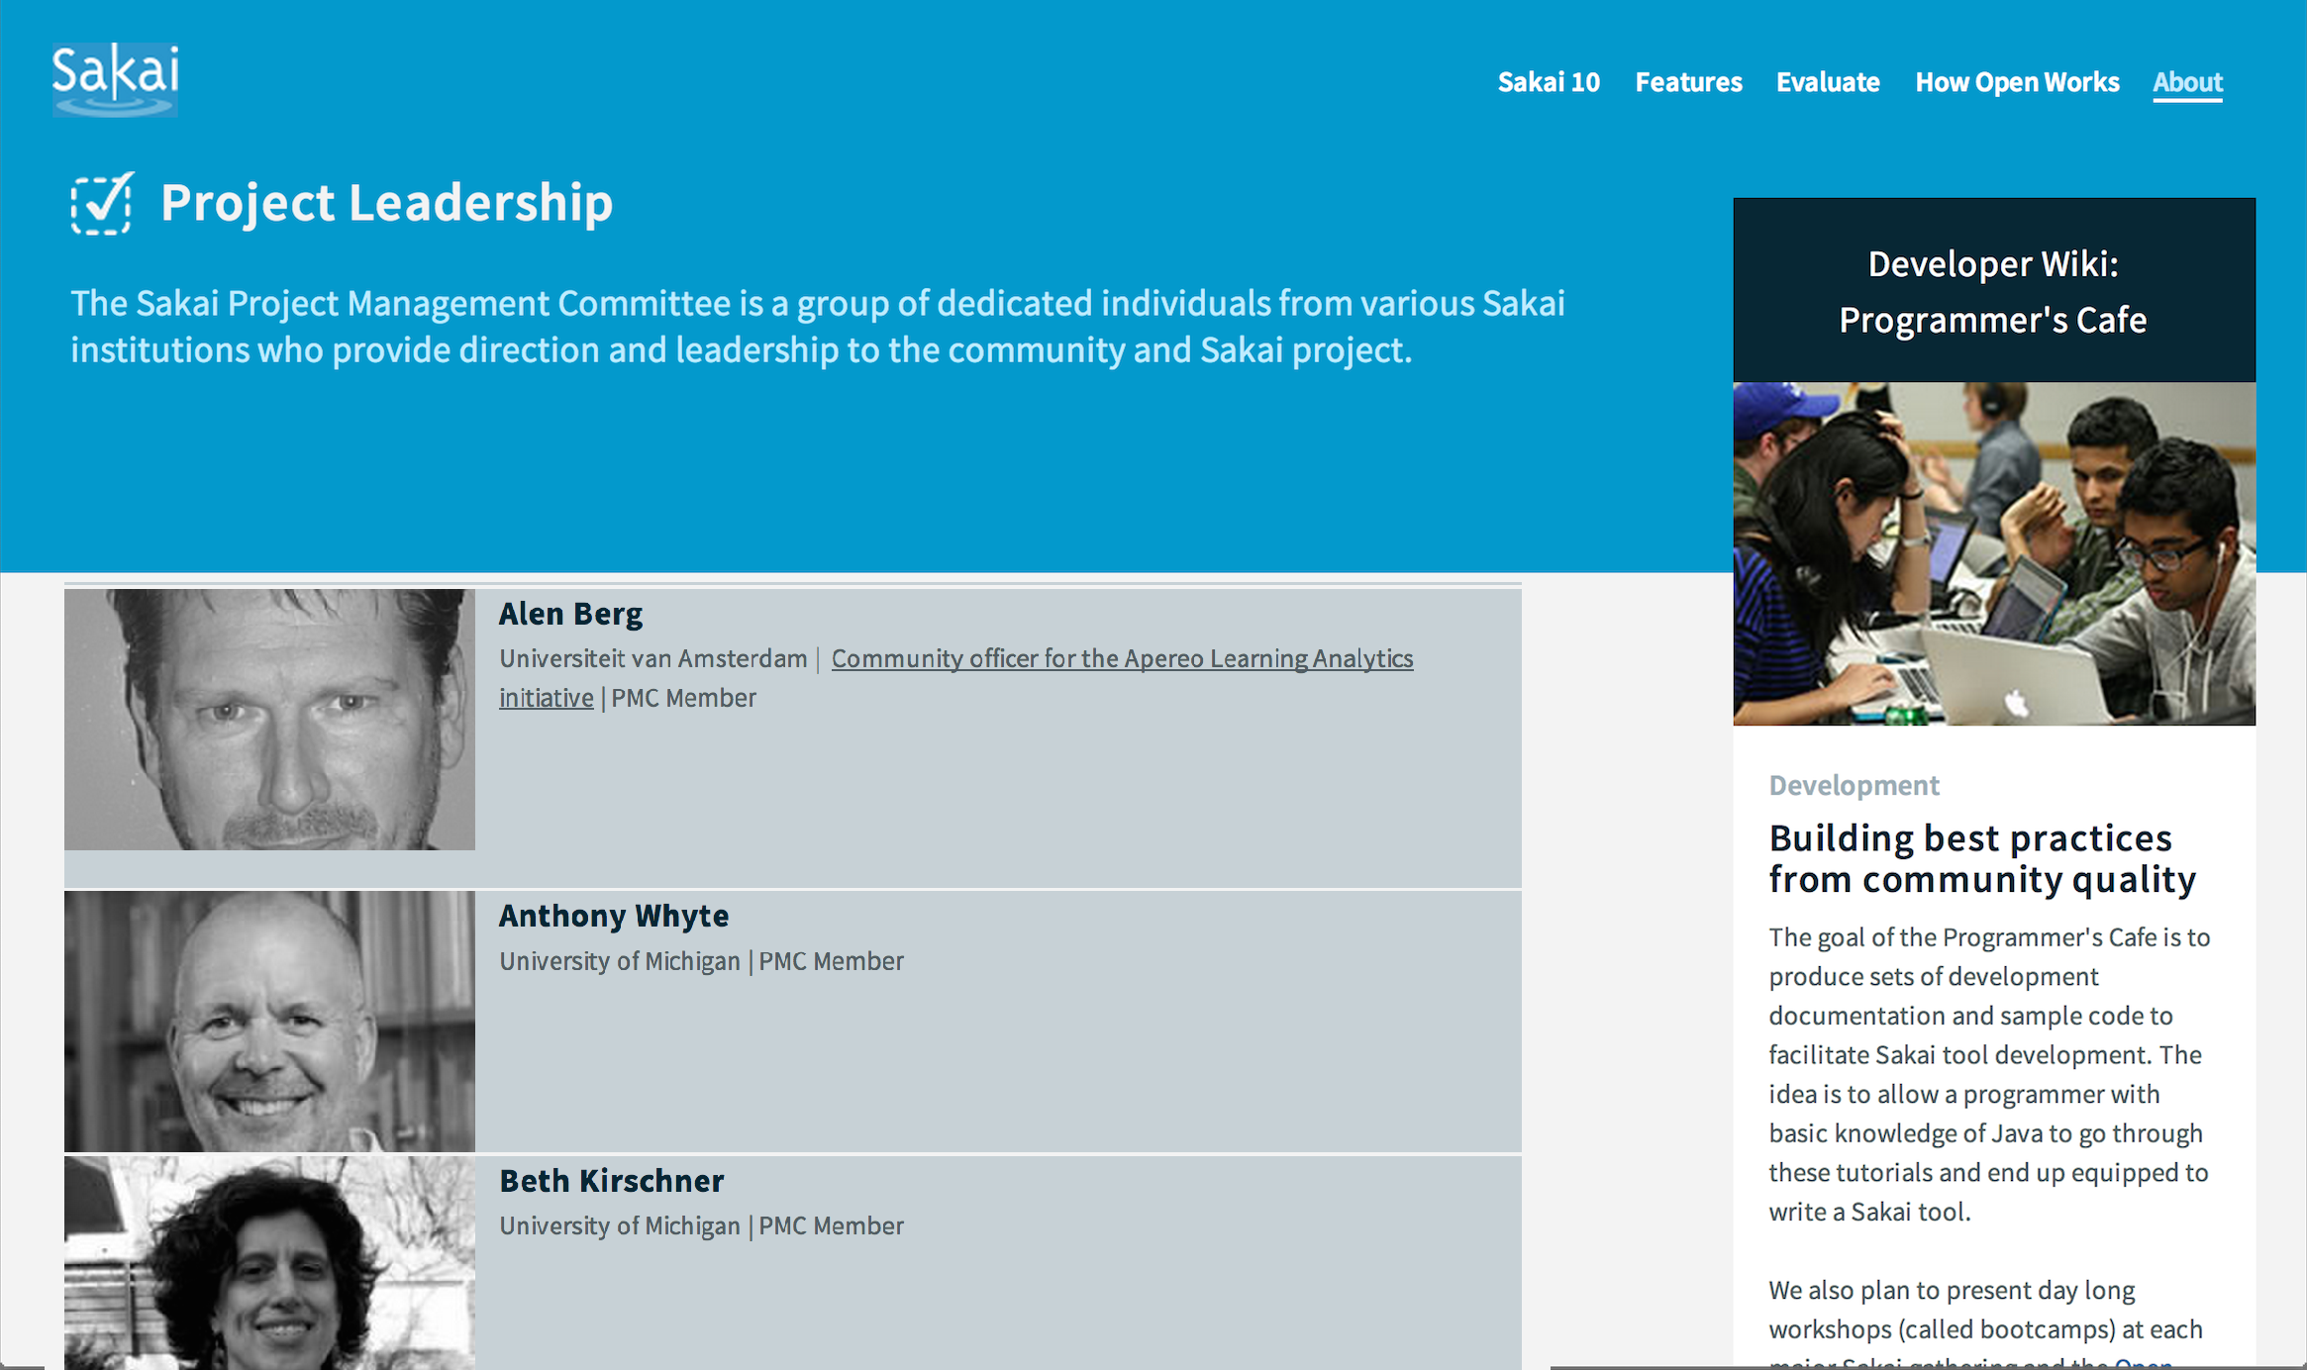
Leadership

Slide 5

Standards
Leading the way in cross-LMS interoperability
Helped found of major IMS Standards
Learning Tools Interoperability (IMS LTI)
Common Cartridge (IMS CC)
First to ship most IMS standards
Most recently IMS LTI 2.0 in Sakai 10

Slide 6

A Decade of Innovation
Sakai 2.9 – Summer 2013
Best in class course navigation
Best in class Lesson Builder (Last major feature)
Sakai 10 – Summer 2014
Improve cost of cloud hosting
UI Improvements / MOOC Influence
Sakai 11 – Fall 2015
Responsive design throughout
UI Surprise and Delight

Slide 7
Sakai 10 (partial List)
Peer Grading Assignments
Group Assignments
Help Improvements
Forums "MOOC-like"
Test and Quizzes – All HTML5 recorder
Syllabus Improvements
Improved messaging
Lesson Builder
Peer rubrics
Polls
Rich Text Editor
Audio record HTML5
Accessible (ARIA)
MathML
Grade Book Extra Credit
Drag/Drop Upload

Slide 8
Roadmap for Sakai?
Historically we have avoided extensive roadmap discussions
Unpredictable resources
Governance layers / expectations / approvals
The governance of Sakai is clear
Commercial providers resources are more consistent

Slide 9
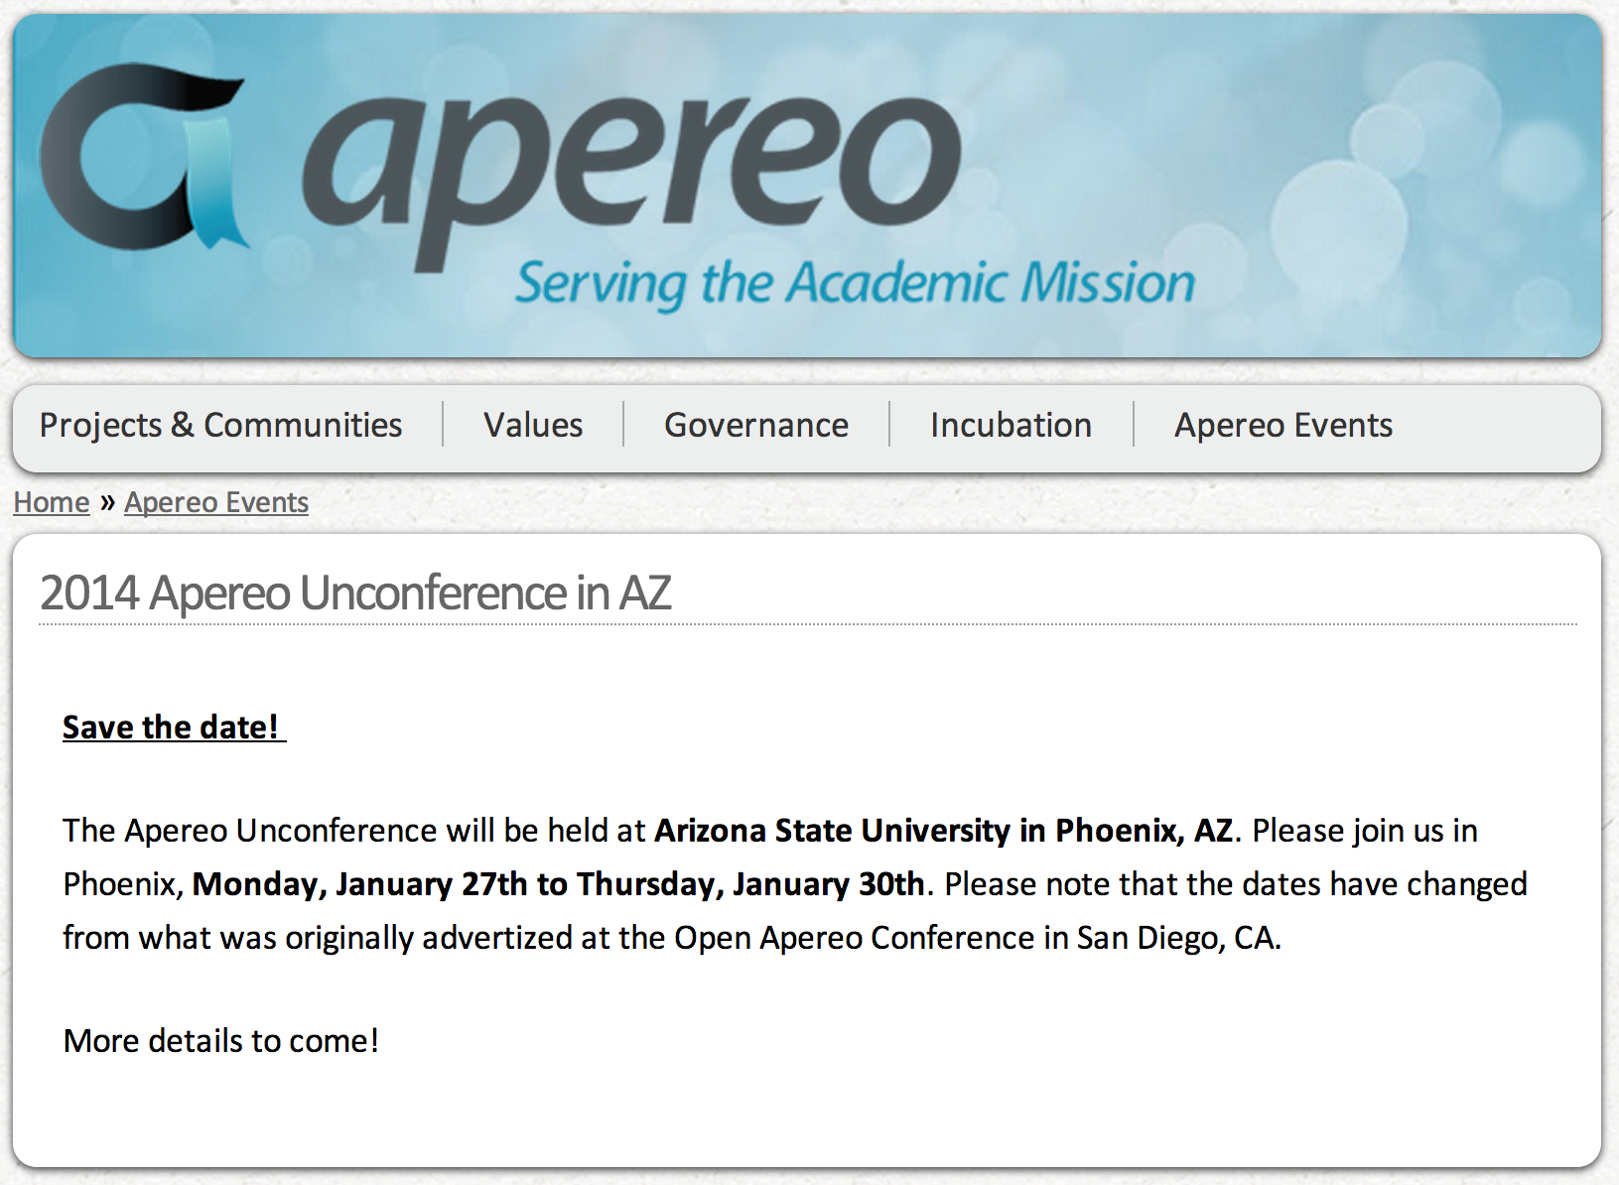
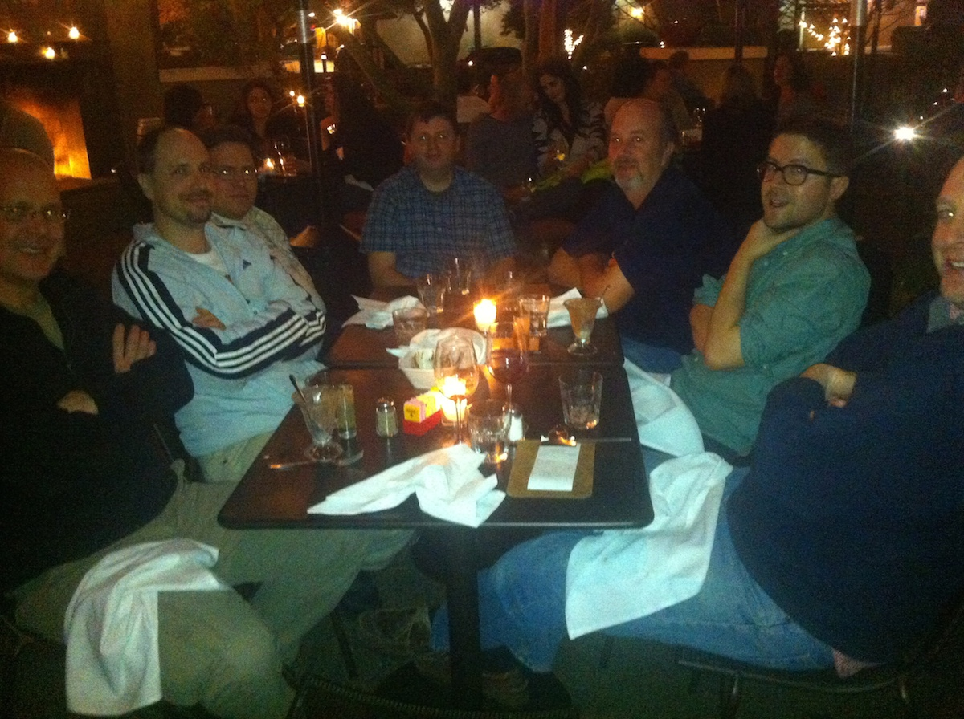

Slide 10
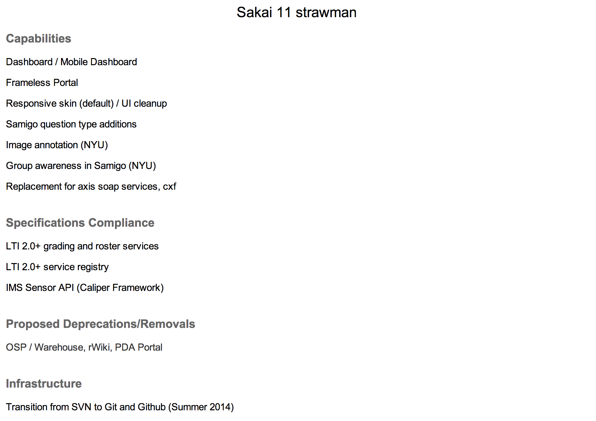
https://confluence.sakaiproject.org/display/REL/Sakai+11+straw+man

Slide 11
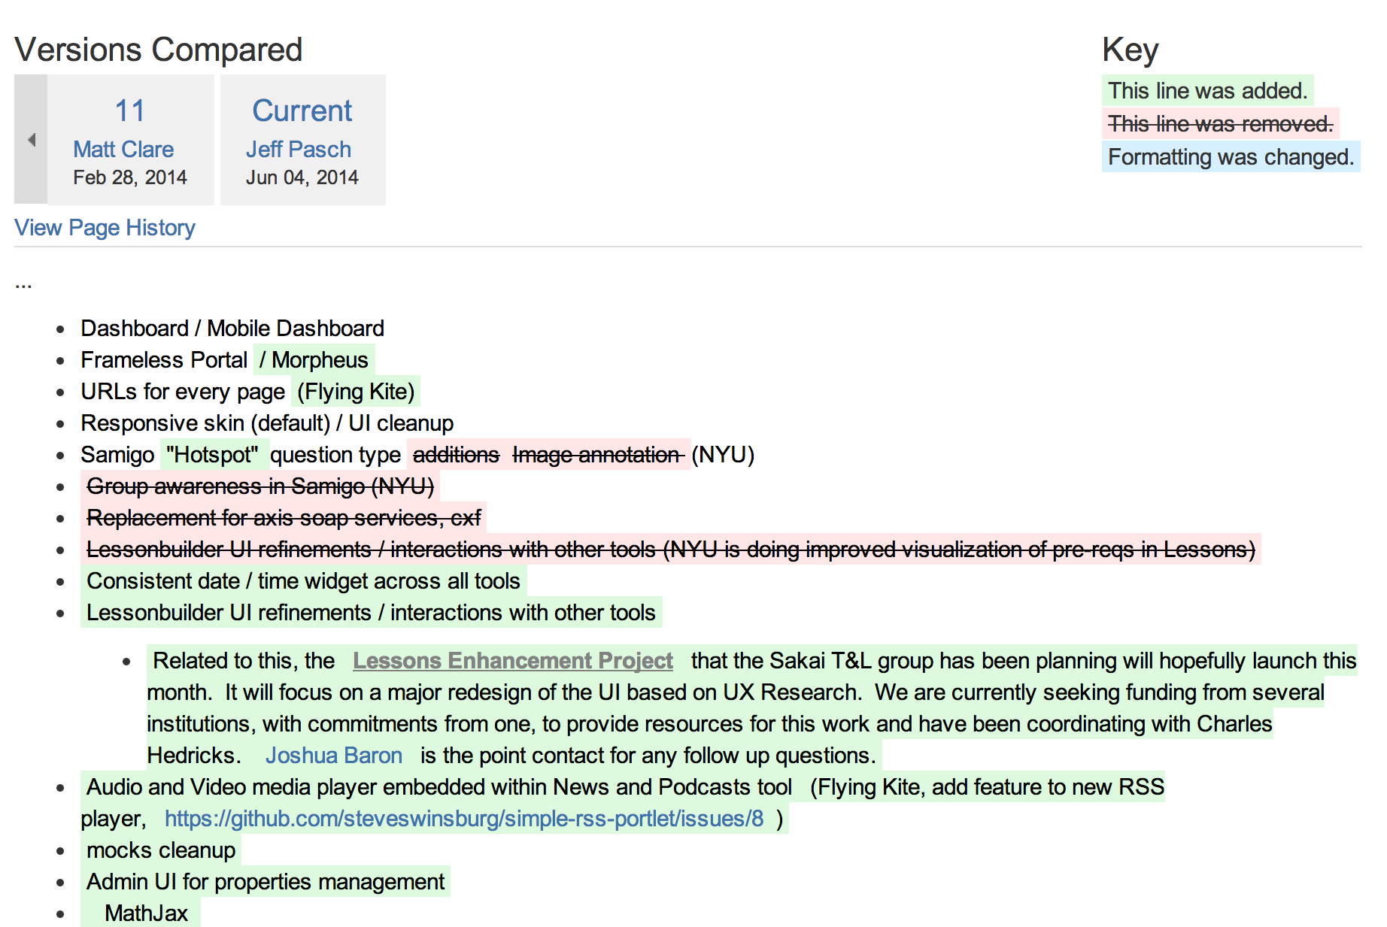
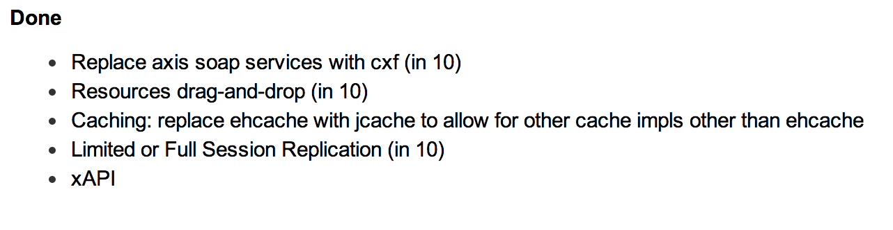
https://confluence.sakaiproject.org/display/REL/Sakai+11+straw+man

Slide 12
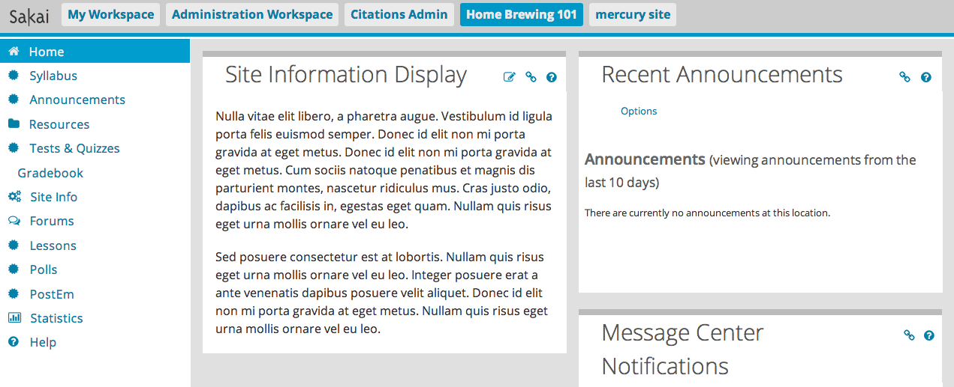
Sakai 11 – Bold Innovation

Slide 13
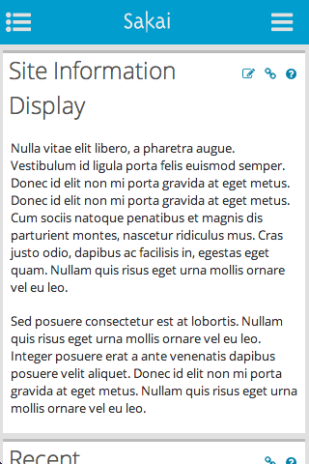
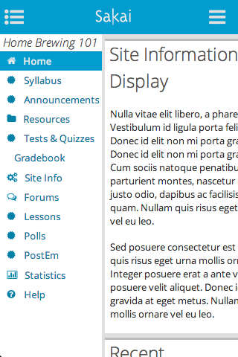
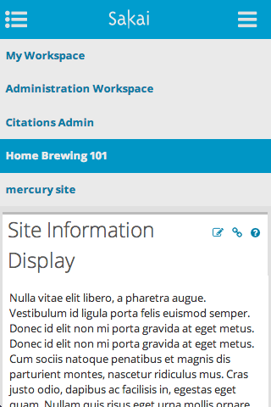

Slide 14
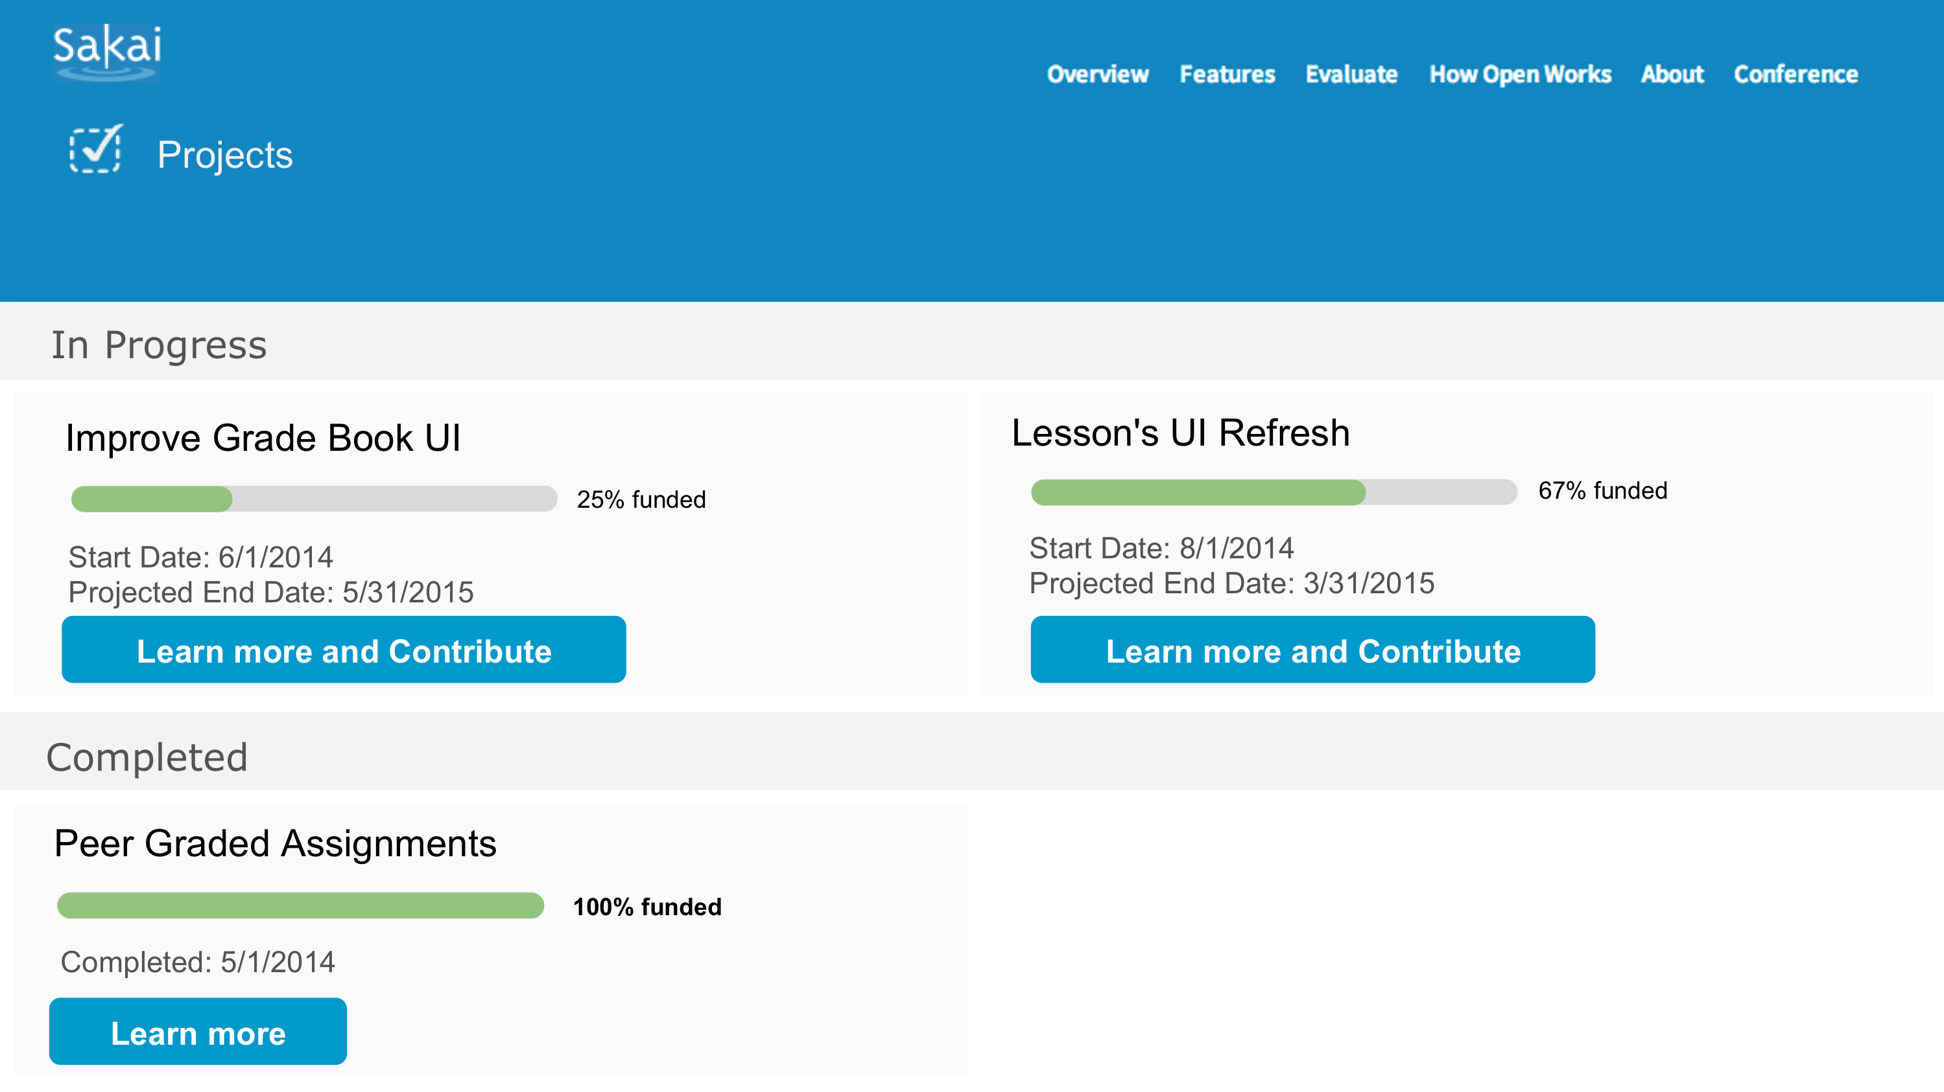
Sakai 11 – User Centered

Slide 15
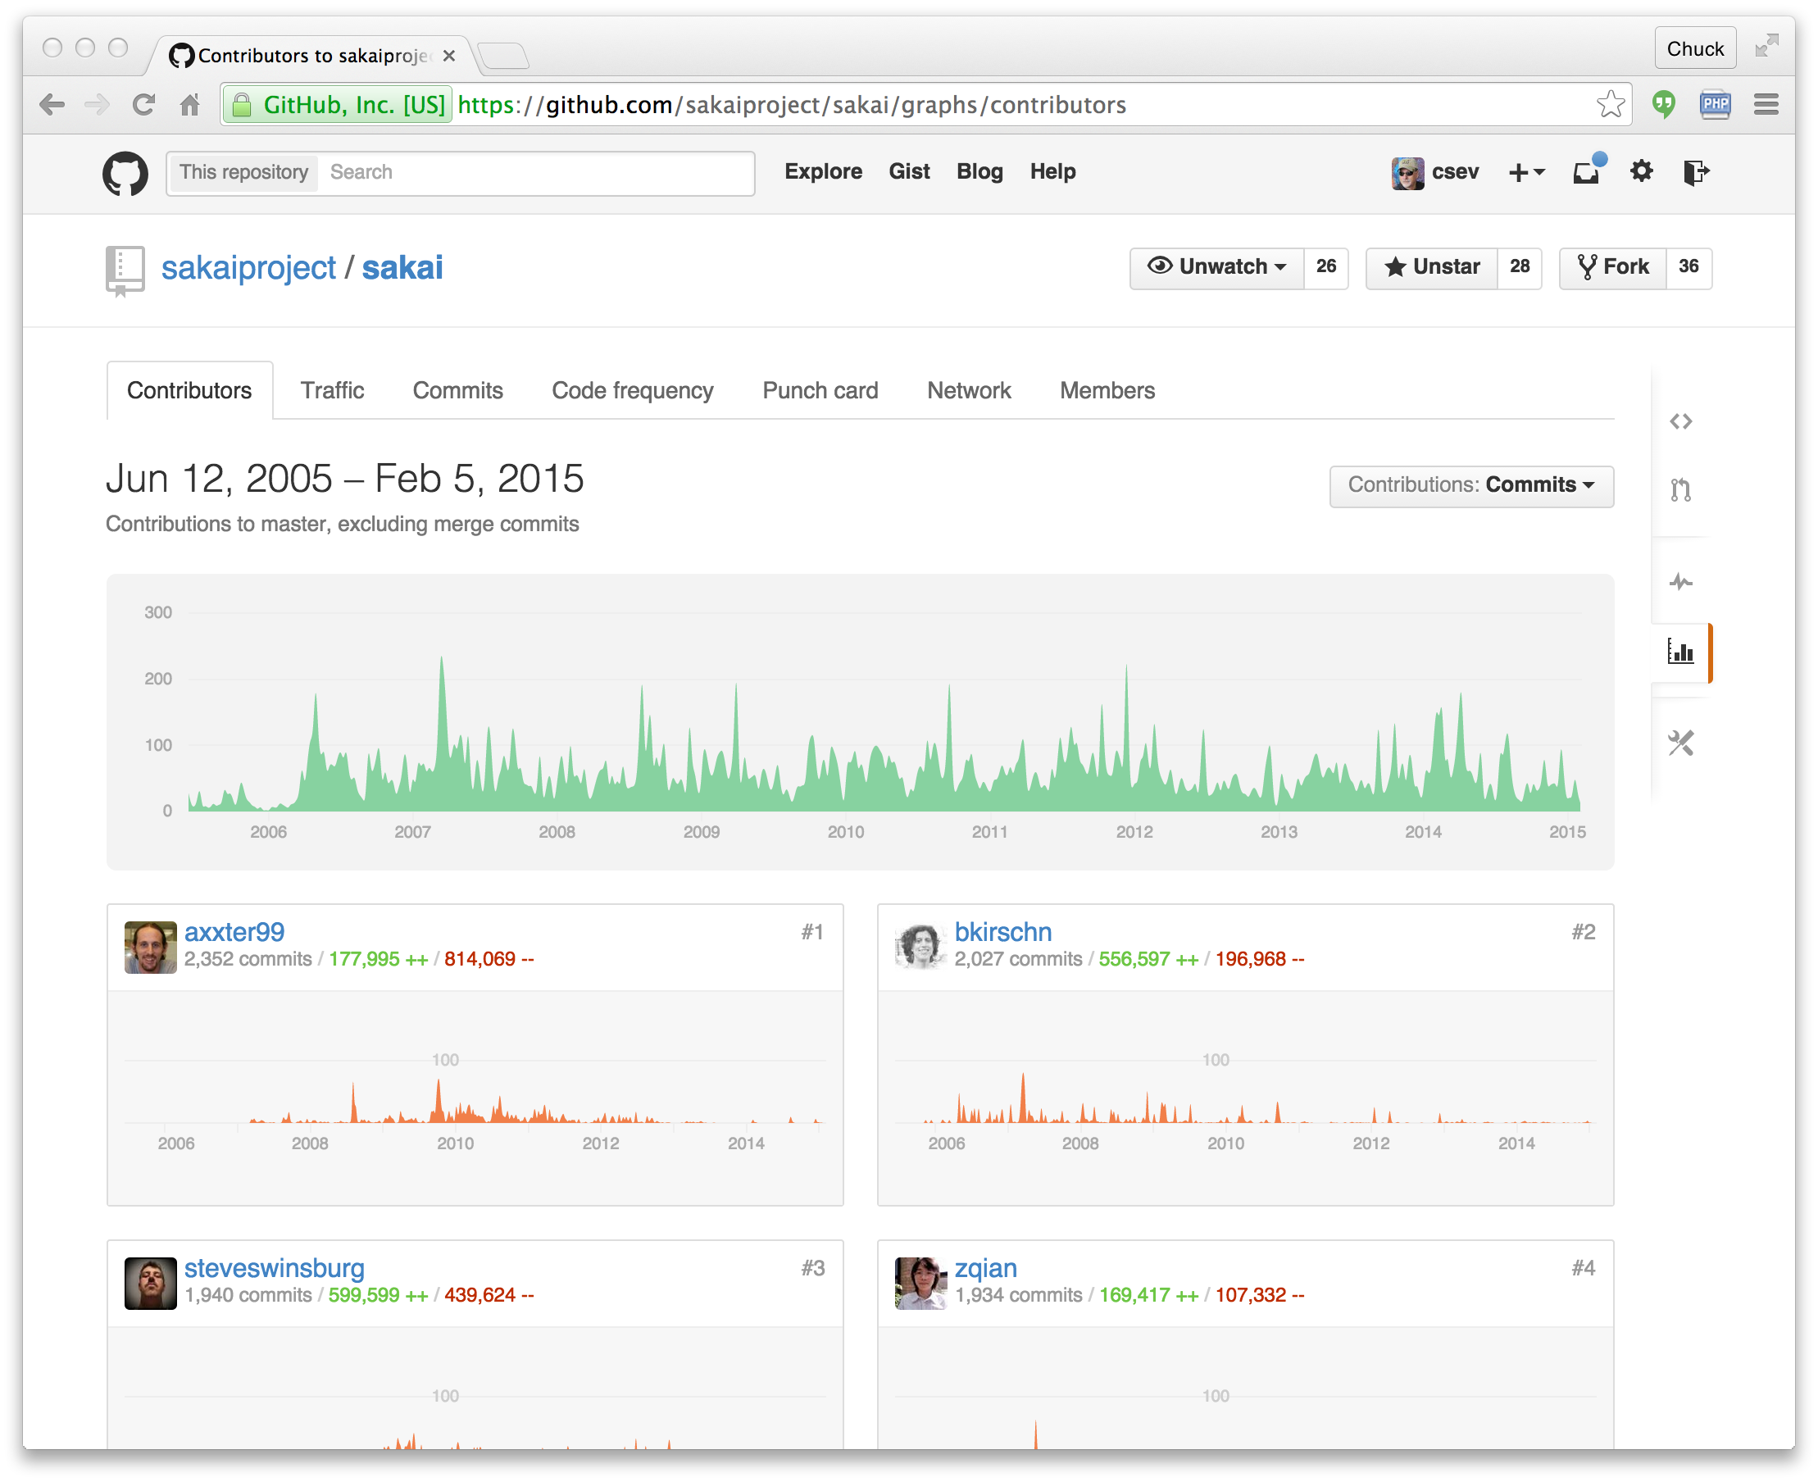
Moved to GitHub

Slide 16
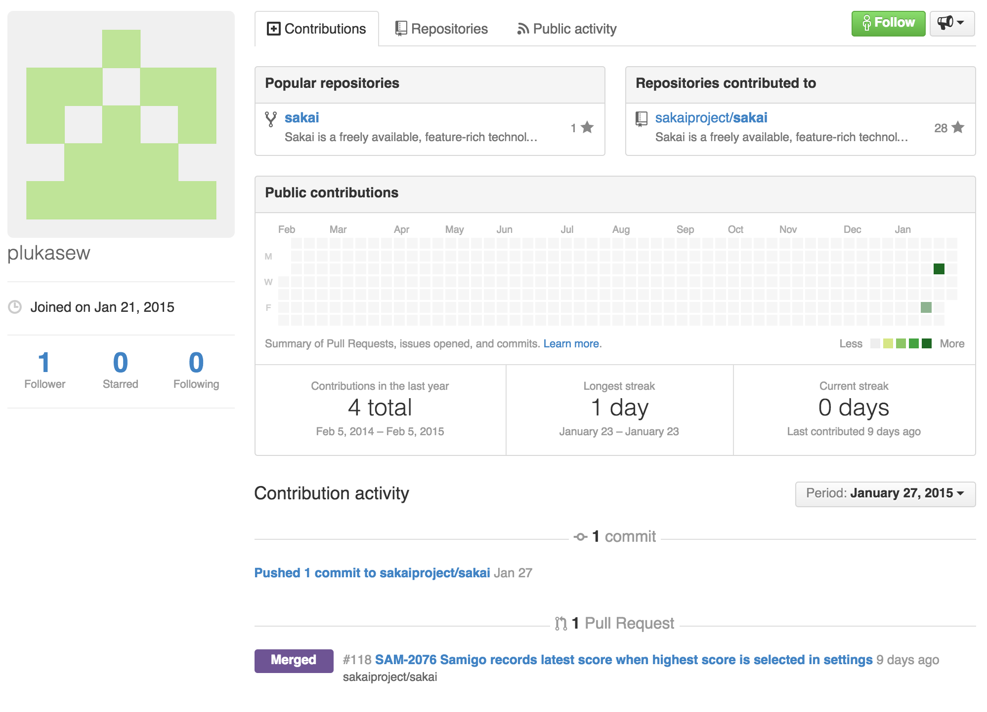

Slide 17
Sakai >11 ???
Improve usability
New functionality is unlikely
Remove functionality / simplify / cleanup
Improve performance
Improve extensibility
More interoperability
Make integration "silky smooth"

Slide 18
The LMS Market
Sakai is not about market share
5-6% of the US market
8-10% of the international market
Many schools still on old software
Angel
Pre Blackboard 9.0
Commercial competition is intensifying
Sakai is the safe, stable and low cost choice

Slide 19
An Open Ecosystem
New Standards
IMS LTI 2.0, IMS LTI Services, Content Item, Content Repository, IMS Caliper, IMS CASA
Apereo Open Analytics Initiative
Tsugi Tool Building Environment
Karuta Portfolio Project
...
www.apereo.org

Slide 20
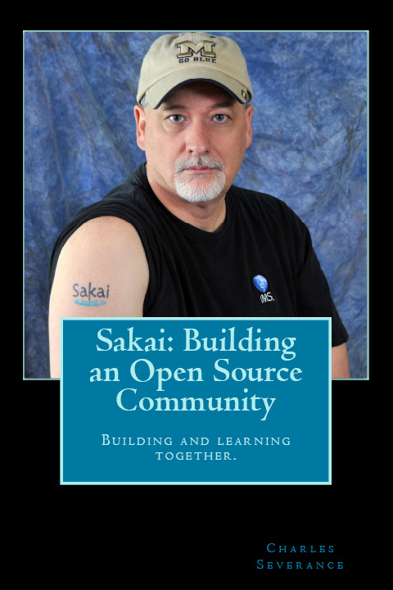
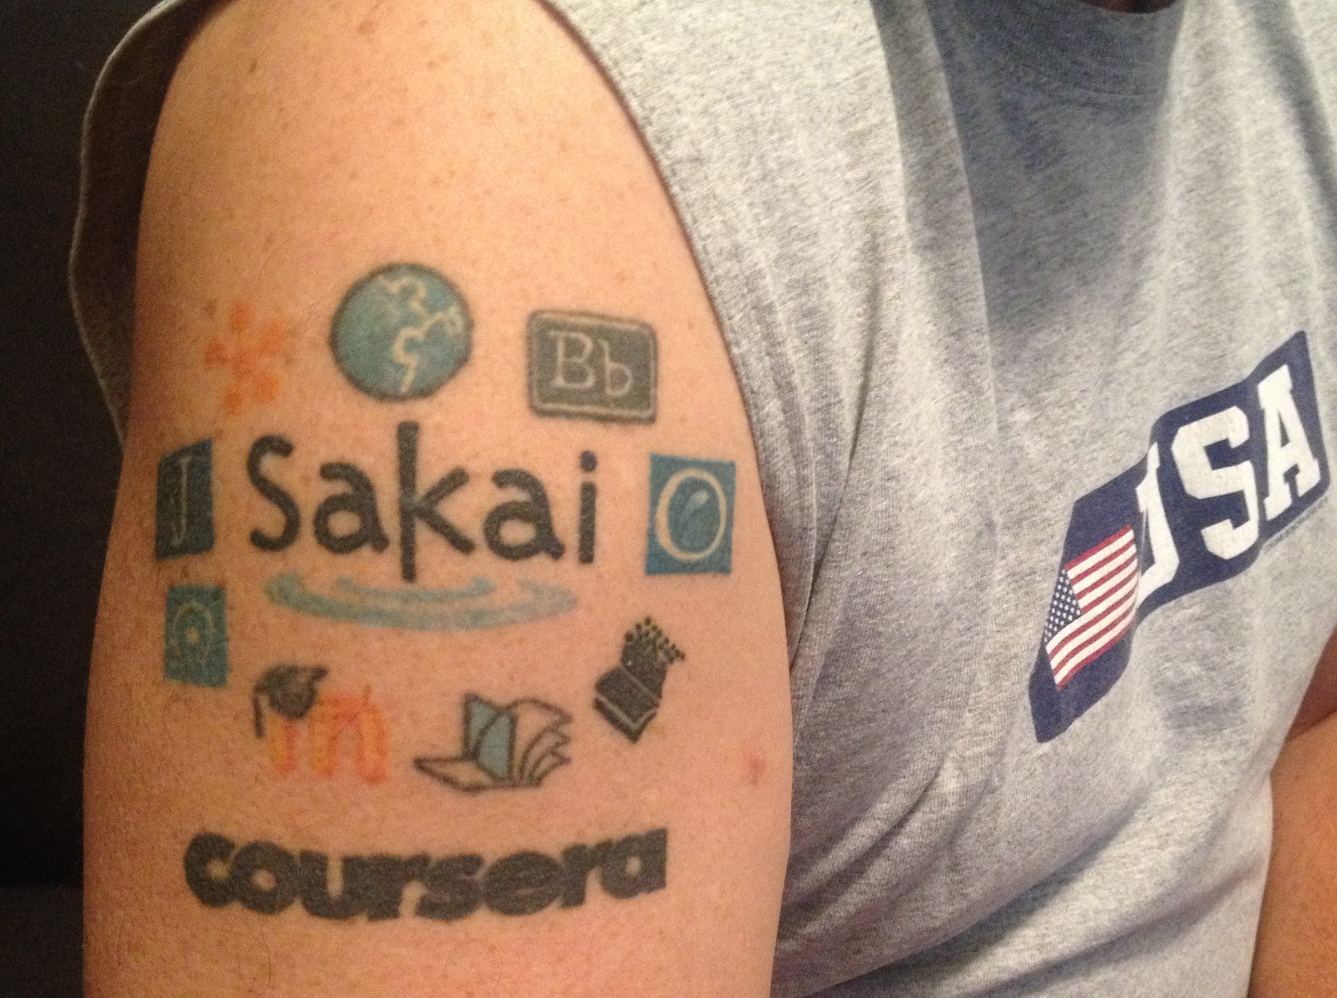
Any Questions?
www.sakaiproject.org

